Slide 1
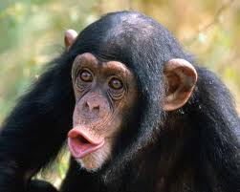
Mammals

Slide 2
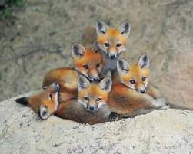
Key Characteristics
Endothermic Vertebrates
Hair
Mammary Glands That Produce Milk to Nourish Young

Slide 3
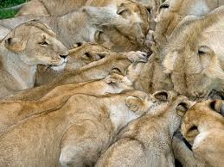
Feeding and Digestion
Varied foods
Teeth, Jaws and Digestive Organs Adapted to Diet.

Slide 4
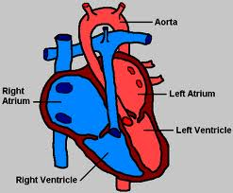
Circulation
Two Loops Circulatory System
Four Chambered Heart

Slide 5
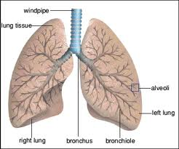
Respiration
Lungs Controlled by Two Sets of Muscles
Moveable Ribs
Spongy Lungs

Slide 6
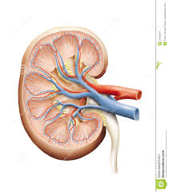
Excretion
Highly Evolved Kidneys Filter Urea From Blood to Produce Urine.

Slide 7
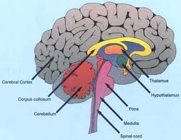
Response
Most Highly Evolved Brain of all Animals
Good Senses

Slide 8
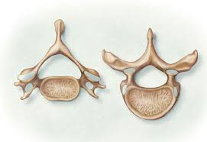
Movement
Flexible Backbone
Varity of Range of Movements
Burrowing, Crawling, Walking, Running Hopping and Flying.

Slide 9
Reproduction
Internal Fertilization
Variance in Development Before Birth
Monotremes- egg laying mammals (5 species in Australia and New Guinea)
Marsupials- Give Birth to live young very early, embryo is born into a pouch to develop.
Placental- Have a placenta that is attached to embryo during development in mother.

Slide 10
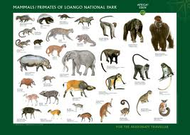
How Many Are There?
About 5,000 Species
Most are Placental Mammals

