Slide 1
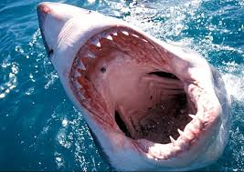
Fishes

Slide 2
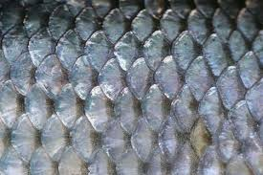
Key Characteristics
Informal description of aquatic vertebrates
Paired Fins
Scales
Gills

Slide 3
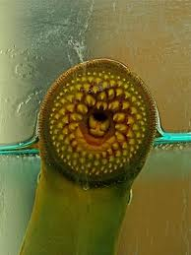
Feeding and Digestion
Herbivores, Carnivores, Parasites, Filter Feeders, Detritivores.
Specialized teeth and jaws
Crop
Esophagus, Stomach, Liver, Pancreas

Slide 4
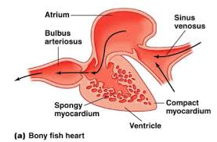
Circulation
Closed
Single Loop Circulatory System
Two Chambered Heart

Slide 5
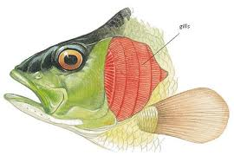
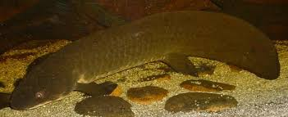
Respiration
Gills
Some have specialized Lungs (Lungfish)

Slide 6
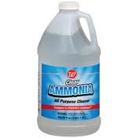
Excretion
Diffusion across Gill Membrane (Carbon Dioxide)
Kidneys (Ammonia)

Slide 7
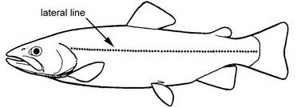
Response
Brain with many parts (lobes)
Highly developed sense organs
Lateral Line System

Slide 8
Movement
Paired Muscles along Spine
Highly Maneuverable
Gas-filled Swim Bladder for Buoyancy

Slide 9
Reproduction
External or Internal Fertilization
Oviparous: Embryos develop in egg outside of mother
Ovoviviparous: Embryo develop in mother, use yolk sac for nutrients
Viviparous: Embryo develop in mother, nourished through mother’s body

Slide 10
Groups of Fishes
Largest group of vertebrates
More than 30,000 species
Jawless fish: Lamprey, Hagfishes
Cartilaginous Fishes: Sharks, Skates and Rays
Bony Fishes: Ray-finned Fishes (trout) and Lobe-finned Fishes (Lungfish and Coelacanths)

