Slide 1
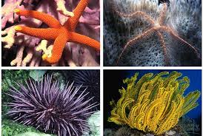
Nematodes, Platyhelminthes, Annelids, Mollusks and Echinoderms

Slide 2
Nematodes (Roundworms)
Unsegmented Worms
Tough Outer Cuticle
Protostomes and Pseudocoelomates
15,000 Species
Many are parasites
Includes: Hookworms, Pinworms

Slide 3
Pineworm

Slide 4
Platyhelminthes (Flatworms)
Soft worms with organ systems
Bilateral Symmetry, Cephalization
Acoelomates
20,000 Species
Three Groups: Trematoda (Flukes), Turbellaria and Cestoda (Tapeworms).

Slide 5
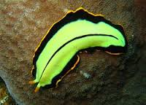
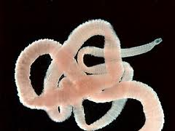
Flukes, Turbellarians and Tapeworms

Slide 6
Annelids
Segmented worms whose segments have internal partitions.
Coelmates
Protostomes
15,000 Species
Three Groups: Hirudinea (Leeches), Polychaeta and Oligochaeta

Slide 7
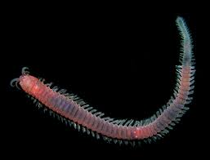
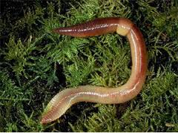
Leeches, Polychaetes and Oligochaetes

Slide 8
Mollusks
Soft bodies with a muscular foot
Many posses a hard shell secreted from the mantle
Coelomates
Protostomes
Bilateral Symmetry
200,000 species
Three Groups: Bivalvia, Gastropoda and Cephalopoda

Slide 9
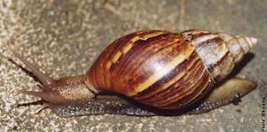
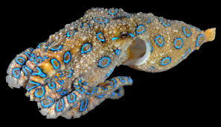
Bivalves, Gastropods and Cephalopods

Slide 10
Echinoderms
Marine animals with spiny skin surrounding an endoskeleton
Tube feet are used for movement and suction
Water vascular system
Coelomates
Deuterostomes
Adults exhibit 5 part symmetry
7,000 Species
Four Groups: Crinoidea, Asteroidea, Ehinoids and Holothuroidea.

Slide 11
Echinoderms
Filter feeders, detritivores, herbivores or carnivores
Circulation through water vascular system
Respiration through gas exchange at surface of tube feet or skin gills
Excretion through tube feet or skin gills
Response through nerve ring, can detect light, gravity and chemicals
Movement by tube feet
Reproduction through external fertilization larvae have bilateral symmetry

Slide 12
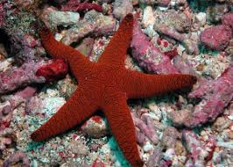
Crinoids and Sea Stars

Slide 13
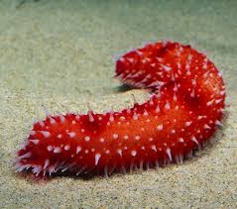
Echinoids and Sea Cucumbers

