Slide 1
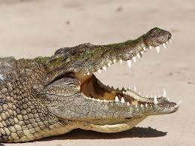
Amphibians and Reptiles

Slide 2
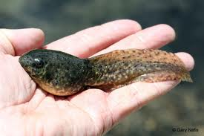
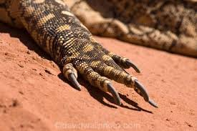
Key Characteristics
Amphibians
amphibian means “double life”
live in water as larvae and on land as adults
lack scales and claws, have most skin
Reptiles
dry scaly skin, have claws and lungs
Amniotic egg

Slide 3
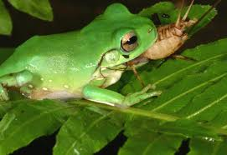
Feeding and Digestion
Amphibians
Tadpoles are filter feeders or herbivores / Adults are Carnivores
Reptiles
Both herbivores with long digestive systems and carnivores that usually swallow prey whole.

Slide 4
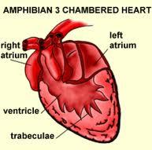
Circulation
Amphibians
Double-loop system with 3 chambered heart
Reptiles
Double-loop system with 3 or 4 chambered heart

Slide 5
Respiration
Amphibians
Larvae breath through skin and gills
Most adult species have lungs, although some retain gills and lungless salamanders breath through the lining of their mouth.
Reptiles
Spongy lungs provide large service area for gas exchange, lungs controlled by muscles and moveable ribs.

Slide 6
Excretion
Amphibians
Kidneys produce Urine
Reptiles
Kidneys produce Uric acid or Ammonia

Slide 7
Response
Amphibians
Well developed nervous system containing very mobile eyes with nictitating membrane / tympanic membrane
Lateral Line system
Reptiles
Well developed senses, some species have infrared detectors that can spot warm bodied prey.

Slide 8
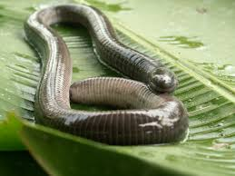
Movement
Amphibians
Larvae have tails / Adults have well developed limbs (except caecilians) / some have specialized toes for climbing
Reptiles
Very strong limbs (except for snakes)

Slide 9
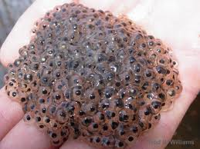
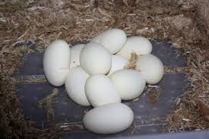
Reproduction
Amphibians
Most lay eggs without a shell
Most undergo metamorphosis from aquatic larvae to adults
Reptiles
Internal Fertilization
Amniotic egg with leathery shell

Slide 10
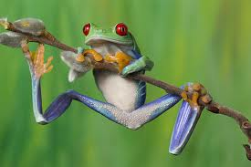
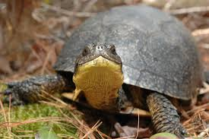
Number of Species
Amphibians
6000 total species 5000 are frogs or toads
Reptiles
9000 species

